Slide 1
Learning SDN with NSX and Open vSwitch as a vSphere admin for fun and profit
By @arielsanchezmor
V1.0

Slide 2
You can find this PPT and any source code in blogs.arielsanchezmora.com
Or tweet @arielsanchezmor

Slide 3
A favor
Take a pic during this session. Tweet it out with #SeattleVMUG
I really like interacting with people in Twitter and the #vCommunity – send me any thoughts from today, your cat pictures and your blog posts!

Slide 4
Agenda
About me
A little history of networking
SDN concepts
How to learn SDN, coming from vSphere
Why I think it’s important to learn SDN
Exploration time, Q&A
Further reading

Slide 5
A bit about me
Costa Rican living in Pittsburgh
Sr TAM @VMware, CTO Ambassador, Skyline SME
Advocate of the vCommunity (vBrownBag, vExpert, VMUG, VTUG, vBeers, vBrisket…)
I started using Twitter in 2013 for VMW
I want to help other people present at VMUG!
vExpert PRO – I’ll help you prepare for vExpert

Slide 6
BIG disclaimer slide
Notice, no VMware logos anywhere
This is purely a community session I geeked up
I am a VMware fanboy though
I believe NSX is the best SDN solution today
It’s important for vSphere admins to learn and adapt to also being network experts to remain relevant & profitable in the multi-cloud future

Slide 7
My background in networking
CCNA and CCNP courses in 2006-2008
NOC engineer, IT operations
In love with OpenBSD and Open vSwitch
I still think CCNA is one of the best network trainings to start. Anyone do the Network+ ?
Networking training isn’t easy
Linux certifications are probably the best to do?

Slide 8
Really appreciate interaction
I’m no networking expert! If you see something wrong or I miss a point, please let me and the room know, this community is here so we help each other
I left some time so we can do practical things, test different things with some kit
May be more about concepts than actual technical doing, but we’ll see what happens!

Slide 9
A little bit of history
In 1969, ARPA awarded the contract to build the most integral piece of this network - a computerized switch called the Interface Message Processor, or IMP - to Bolt Beranek and Newman (BBN), a small Cambridge, Massachusetts, company.
A half-dozen engineers at BBN, who called themselves the IMP Guys, knew it was possible to do what larger companies - including AT&T and IBM - had dismissed as impossible. But making computer networking possible required inventing new technologies.
Where Wizards Stay up Late: The Origins of the Internet amazon link

Slide 10
The rise of the networking silo
In the beginning, the sysadmin did all the networking
To this day BSD-based routers and firewalls power most of the internet, because of stability and permissive licensing
A brief history of Cisco’s rise
The recipe was to buy bigger switch/router/firewall to handle demand

Slide 11
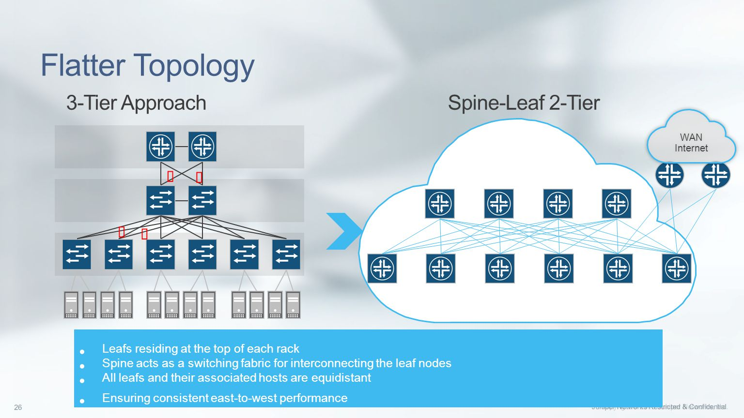
A different way came along
Benefits of scale out (leaf-spine) vs scale up

Slide 12
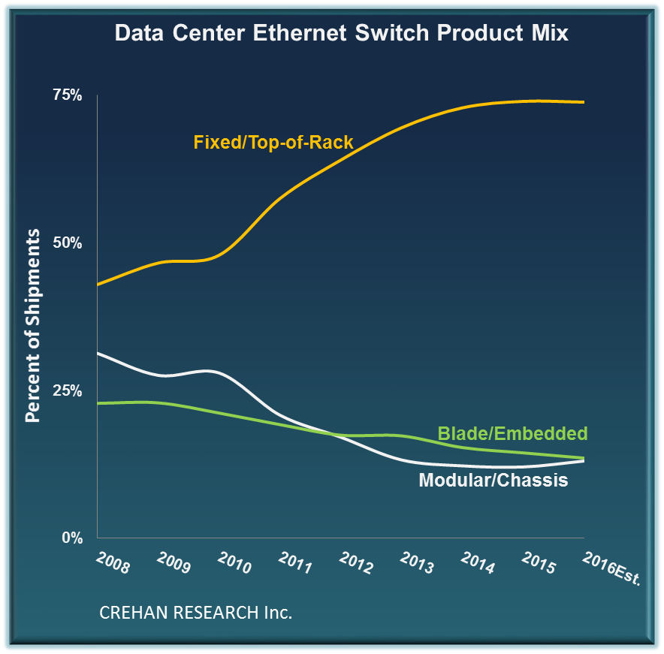
The trend has reached mainstream

Slide 13
Networking changes
A big breakthrough was the invention of overlay networks
Management of individual devices, upgrade and migrations of big devices was very painful
Servers/NICs became cheaper, buy direct
Cloud scale companies solved the problems themselves, with the help of academics

Slide 14
What is Software Defined Networking?
Remove dependence on hardware vendor management interfaces
Operating an open management/control plane separate from data plane
Dictate forwarding behavior from a central point, running as a distributed system
Programmability of network manipulation

Slide 15
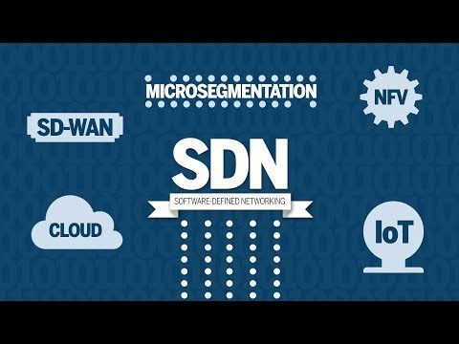
A recent video

Slide 16
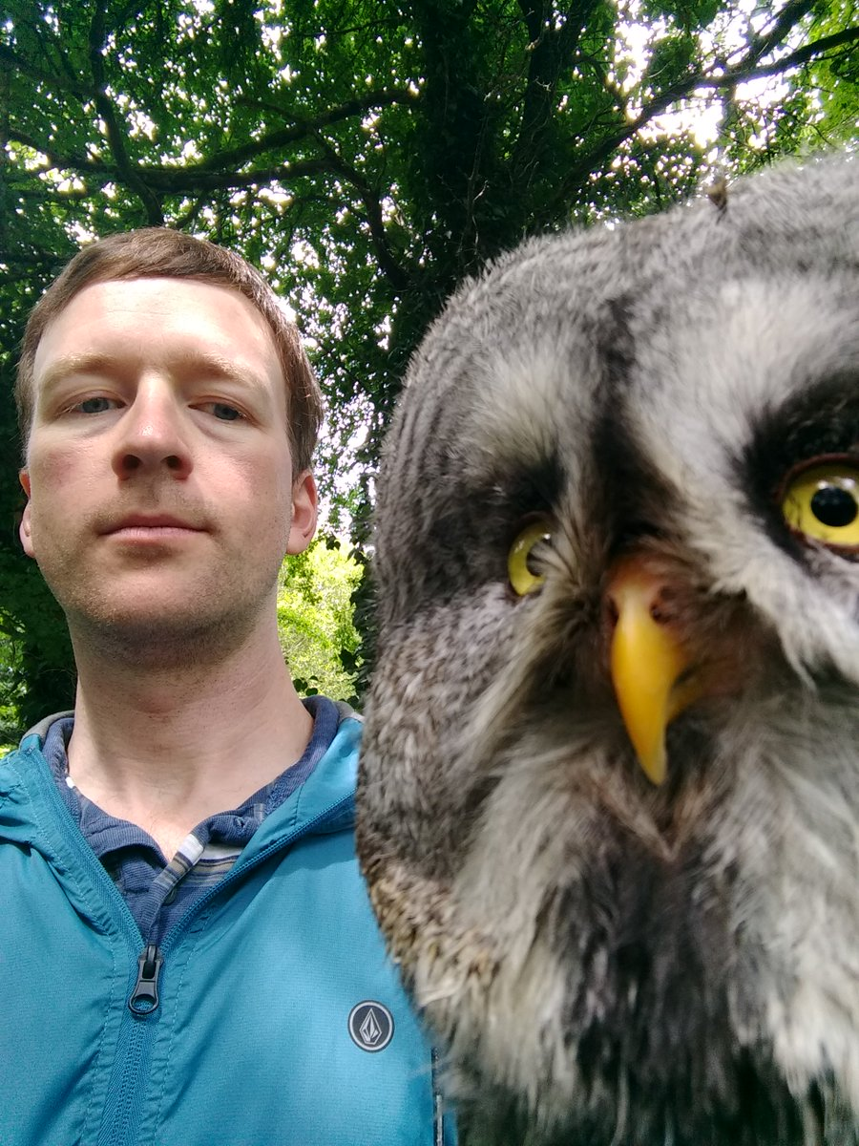
History and concepts of SDN
Nicira -> Open vSwitch -> NSX
Nicira was co-founded by Martin Casado, who served as the CTO, Nick McKeown and Scott Shenker
Ben Pfaff, an early employee, has been great at promoting Open vSwitch and SDN

Slide 17

My interview with Ben
Who is Ben Pfaff 1 2
Nicira and Open vSwitch story 1 2 3
What is Open vSwitch?
Control / Data planes, OpenFlow, ONF
How much OvS is used by NSX-T?

Slide 18
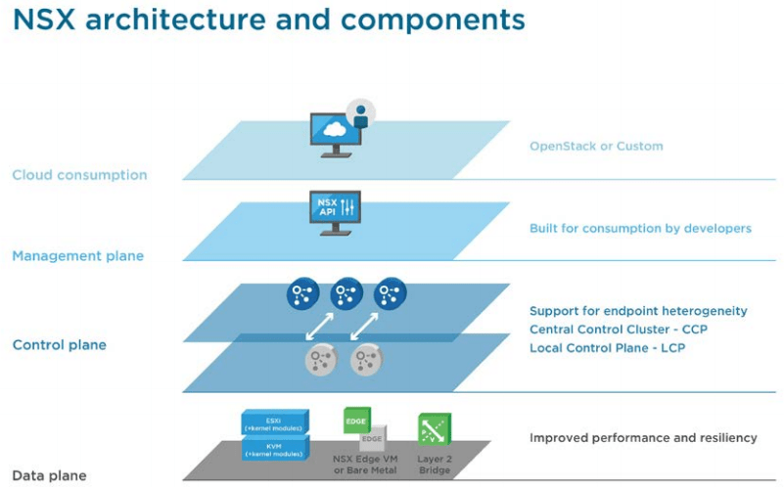
NSX Data Center for vSphere

Slide 19
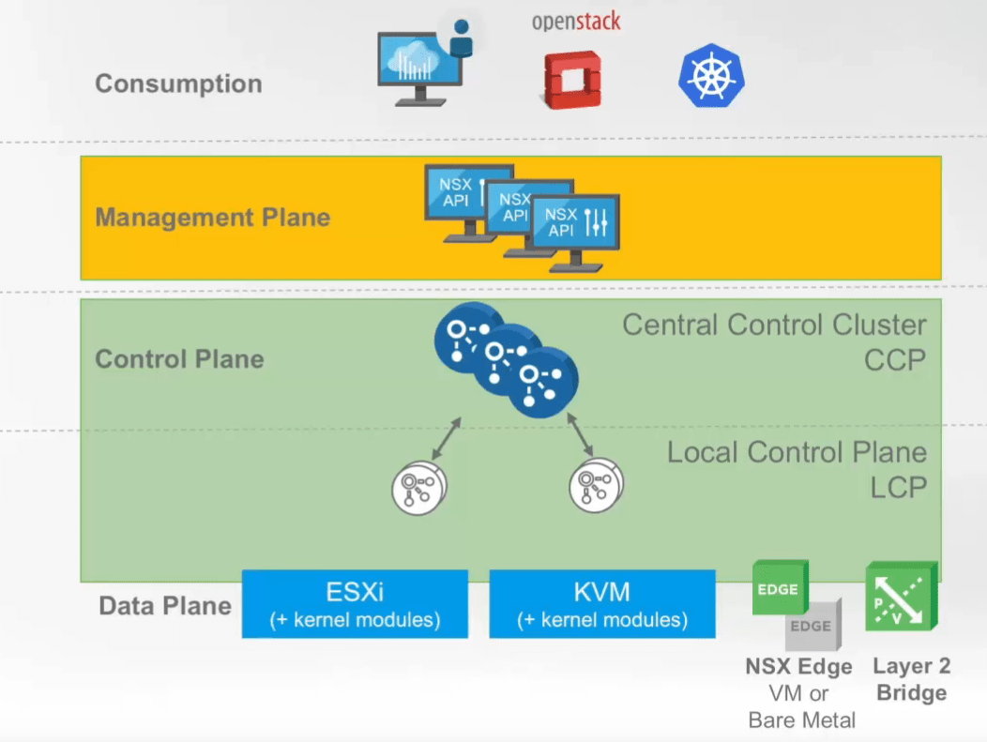
NSX-T for Data Center
Works with several Compute Managers
New N-VDS or OvS

Slide 20
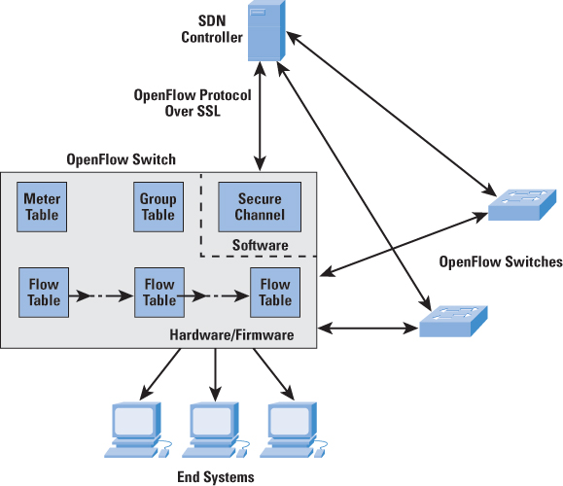
Openflow / Open vSwitch
Several OpenFlow controllers
Production quality open source software switch

Slide 21
Concepts in common for SDN
Network services: routing, switching, load balancing, firewalling (all layers)
There’s a hypervisor (vSphere, Linux KVM host)
There’s a vSwitch (vSphere standard or distributed, N-VDS for NSX-T, open vSwitch)
There’s a differentiation from data, control and management planes
Requirement is to scale and upgrade software on demand

Slide 22
Learning SDN with NSX/OvS
We need a networking background (TCP/IP, routing, firewall concepts)
Hey if you’re CCIE this is easy!
NSX-V Install Configure Manage, Troubleshooting and Operations (NSX-T now has ICM as well!)
SDN Associate Certification https://www.opennetworking.org/skills-certification/

Slide 23
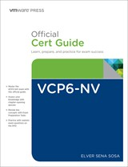
Learning NSX from scratch
VCP6-NV
Elver Sena Sosa’s book is AMAZING
VCAP6-NV free training
There’s no substitute for hands-on
Hands on Labs (nine labs now)
VMUG Advantage (typically discounted today)
Great NSX demo site to show co-workers

Slide 24
Learning Open vSwitch
Go to openvswitch.org
Watch Youtube videos (my SDN playlist)
Start with Linux VMs
Find a cheap Open vSwitch enabled switch
Northbound networks sold several cheap ones
Find OpenFlow compliant whitebox switches

Slide 25
Why I think it’s important to learn SDN
We’re told that IT has to be faster
Programmable, embedded security
Cloud speed (resources at the standby for consumption and cost optimization)
Networking is no longer the sole domain of the networking team – because of cloud
Learning the 3 main Cloud VPCs is one of the best things you can do today

Slide 26
SDN programmability
Your 2019 skill to have: interact with REST APIs
The real power comes from the automation (think Ansible or Terraform) capabilities to provision new networks and services
The networking folks are just waking up to the revolution you’ve heard for years (Git, infrastructure as code)
Software Gone Wild and Packet Pushers

Slide 27
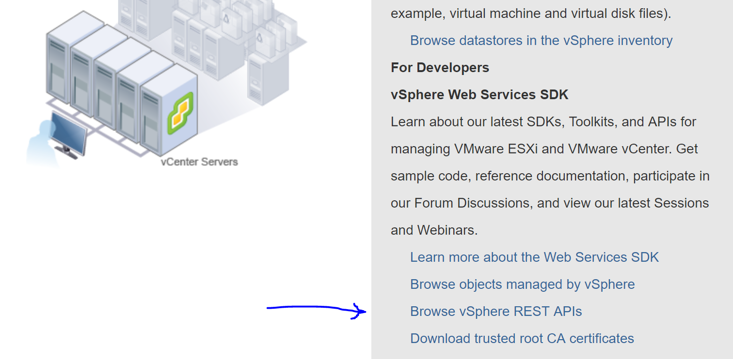
Getting started with REST APIs
https://vCenter/apiexplorer
Kyle Ruddy did an excellent vBrownBag video

Slide 28
Further Reading
With NSX you really want to dig into the documentation
NSX Data Center for vSphere documentation and 6.4.4 installation guide
NSX-T Data Center documentation and 2.3 installation guide
VMTN forums are very active!

Slide 29
My favorite links on SDN
SDN by Wikipedia
OpenFlow by Wikipedia
Leaf spine by Mellanox and Pica8
Amit Vahdat of Google Networking explaining their pain points that led to SDN adoption
Today, just Google and watch some videos, note the date as some are from early 2000s

Slide 30
Keep up to date with OvS
OvS Orbit podcast (65 episodes!)
OvS Con Youtube Channel (2015-2018!)
Follow Ben_Pfaff https://twitter.com/Ben_Pfaff
Mailing list https://mail.openvswitch.org/mailman/listinfo

Slide 31
Keep up to date with general SDN
Justine Sherry is a Carnegie Mellon University professor and very active on twitter
https://twitter.com/justinesherry
http://www.justinesherry.com/
Programmable Networks Course schedule with reading assignments

Slide 32
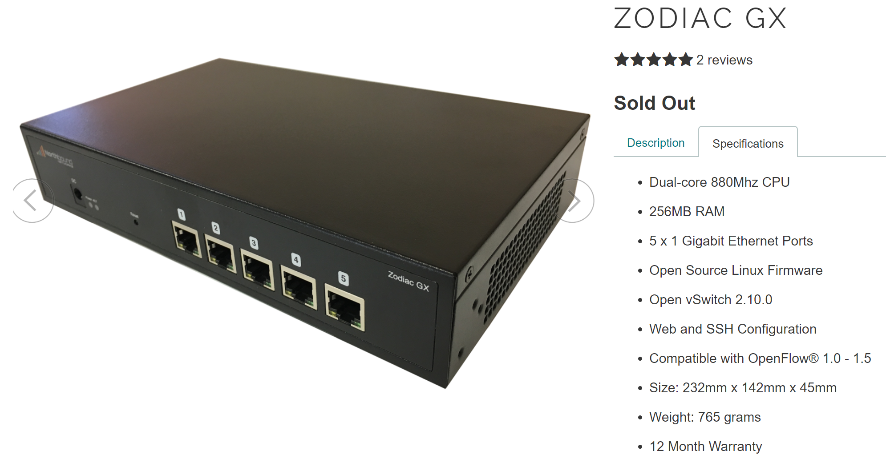
Homelab strategy
I brought my small homelab with me!
Pi, Linux host, host with vCenter

Slide 33
Things I want to do in the future
Wireless AP from the Pi for the exploration part
Install Faucet as an OpenFlow Controller as a container in the Pi, following this Demo by Ben Pfaff
Connect both the ZodiacGX and the Linux host to the controller, and compare to NSX-T
Show some flows, overlay networking in real time

Slide 34
Let’s explore and have fun!
Raspberry Pi (wireless, DNS) – SDNCATS
Zodiac GX OvS switch http://192.168.1.249
vCenter 192.168.1.202, host 192.168.1.101
Linux VMs 192.168.1.232/233
Linux host 192.168.101
All passwords VMware1!, user root or administrator@vsphere.local

Slide 35
We’re done ☺
First time giving this talk, please please give feedback to me
I have some ideas on what else I can do, but I want to know what you got out of it
@arielsanchezmor on Twitter or in the VMware Code Slack

